Slide 1





HTML FUNDAMENTAL
Digital Media I

Slide 2






About Me
Educational Background
Work Experience
Candidate - Masters in Computer Science & Technology
Zhejiang Sci-Tech University
June 2018 - Present
NOC Technician - Liberia Telecommunication Corporation
Philip S. Bargin, Jr.
Candidate - Masters in Management Information System
UNICAF University Zambia
October 2019 - Present
Executive Director - Innovations Hub Liberia
Bachelor Degree - Information Technology
Starz University
March 2019 - Present
Part-time Lecturer - Starz University
Contact Details
Follow me social media
philipbargin@gmail.com
Philip Bargin
PhilipSBarginJr
Philip Bargin
measonbargin
(+231) 880719322 / 770198161

Slide 3

SELF-INTRODUCTION
Now that you know me, let's get to know you.
01
Your Full Name
04
Work Experience and Give Details
02
Major
05
Habits
03
Status/Level
05
Expectations of this course

Slide 4



Ground Rules
No session in session
Make sure to attempt all class activities
No eating, no chewing
Attend all class and on time (Physical/Virtual)
Respect others view
Avoid unplugging system and bring water close to the systems
Make the internet your friend

Slide 5



Grading Scale
A total of 100 marks/percent or A is easy to achieve for this course.
Tools for this Class
Attendance .......................... 10 marks
Google Classroom
01
WhatsApp & Telegram
02
Class Participation .......... 5 marks
GitHub
03
Assignments & Quizzes ... 15 marks
Spck Code Editor (Phones)
04
Mid-Term Exam ................... 25 marks
Visual Studio Code (PC)
Final Project ........................... 15 marks
Zoom
05
Final Exam ................................ 30 marks
06

Slide 6
Objectives
01
Understand HTML and why you should learn it.
03
Understand code editors and what they are use for.
02
Discuss the History and different versions of HTML.
04
Discuss and understand the basic structure of a HTML document

Slide 7

What is HTML
Let's brainstorm

Slide 8

What is HTML?
HTML stands for Hyper Text Markup Language which is the most widely used language on web to develop web pages
HTML is the standard markup language for creating web pages
Hypertext means that the document contains links that allow the reader to jump to other places in the document or another document altogether
A markup language is a way that computers speak to each other to control how text is processed and presented

Slide 9
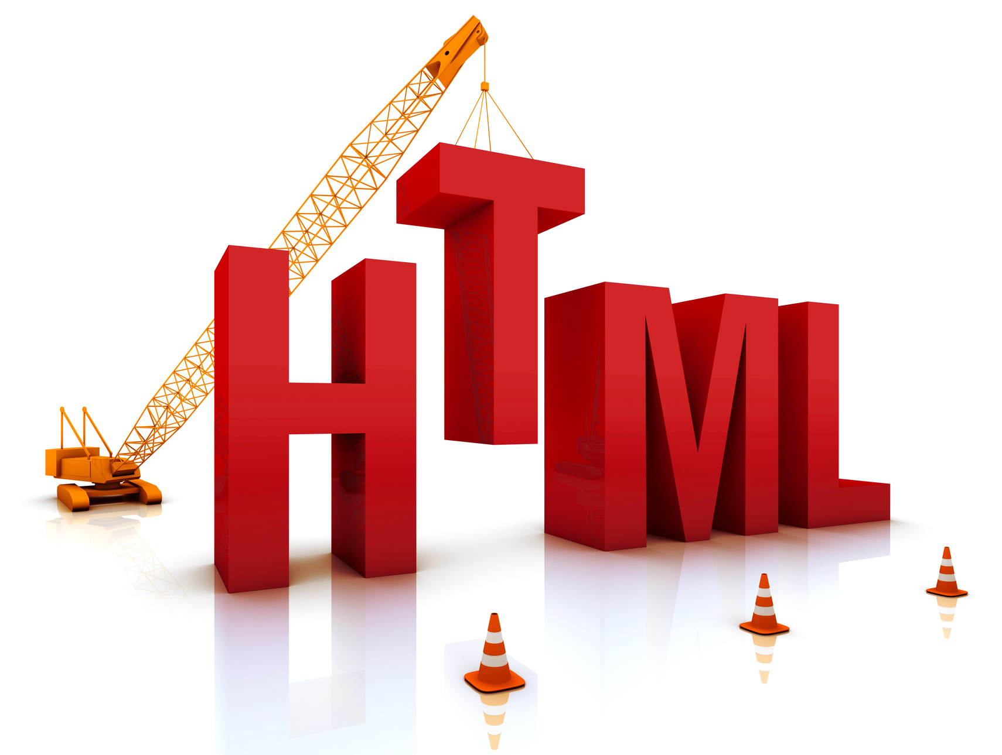
History of HTML
HTML was invented from the prototype written by Tim Berners-Lee in 1991
HTML has a life span of roughly 28 years
HTML is based on SGML(Standard Generalized Language)
HTML 5 is the latest and most enhanced version of HTML. Technically, HTML is not a programming language, but rather a markup language.

Slide 10

Versions of HTML?
2012
HTML 5
HTML 4.1
2000
XHTML
1999
HTML 2.0
1997
HTML 3.2
1995
HTML
1991

Slide 11

HTML vs XHTML
CASE SENSITIVE
ATTRIBUTE DECLARATION
NESTING ELEMENTS
EMPTY ELEMENTS
SCRIPT INCLUSION

Slide 12
What is Code Editor?
Computer software
Text Editors
A HTML code editor is a computer program or software for creating or/and editing HTML documents or web pages.
An HTML file is a text file, so to create an HTML file we can use any text editors.
We can know only that we know nothing. And that is the highest degree of human wisdom.
Code editors for this class
For this class, we will use Spck Code Editor and Visual Studio Code editor.

Slide 13
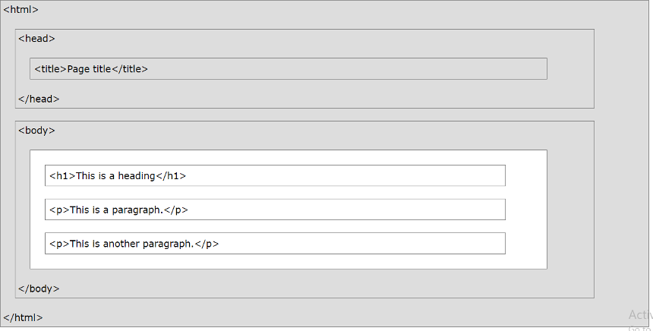
Basic HTML Structure

Slide 14


Description of HTML Example
<!DOCTYPE html>: It defines the document type or it instruct the browser about the version of HTML.
<html > :This tag informs the browser that it is an HTML document. Text between html tag describes the web document.
<head>: It should be the first element inside the <html> element, which contains the metadata (information about the document). It must be closed before the body tag opens.
<title>: As its name suggested, it is used to add title of that HTML page which appears at the top of the browser window.
<body>: Text between body tag describes the body content of the page that is visible to the end user. This tag contains the main content of the HTML document.

Slide 15





Summary
HTML stands for Hypertext Markup Language and it is the language widely use for creating web pages.
HTML is a must for students and working professionals desiring to become a great software engineer and web developer.
HTML was created using the prototype design by Tim Berners-Lee in late 1991
HTML code editor is a computer program or software for creating or/and editing HTML documents and web pages.

Slide 16
Thank You
ANY QUESTIONS?

